Slide 1


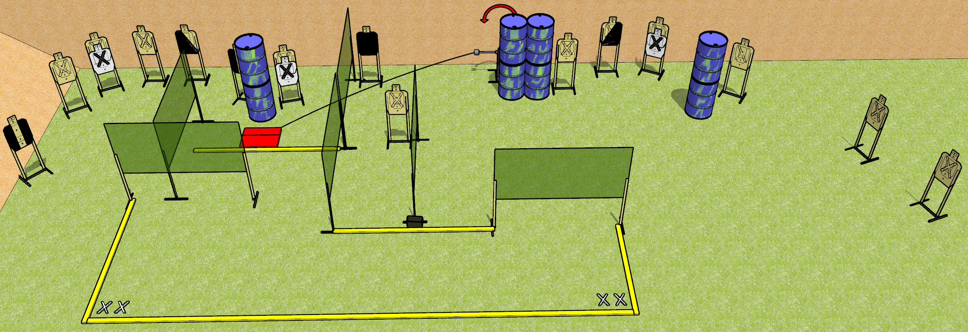
 | Dothan Gun Club – USPSA Match Who put that wall there??? Course Designer : Drew Coleman
START POSITION : Standing with both feet on either set of marks. Hands relaxed at sides.
GUN READY CONDITION : Pistol loaded and holstered. PCC shouldered, safety on, pointed at ammo can. |  | SCORING: Comstock, 32 rounds TARGETS: 16 paper, 0 Steel SCORED HITS: Best 2 on paper, steel until down START-STOP: Audible, last shot RULES:
STAGE PROCEDURE: Engage targets as they become available from within the fault lines. Stomp box may only be activated by PLACING the ammo can on top of it.

